Slide 1



MODSIM-GSFLOW
Eric Morway, NV WSC, Carson City, NV
Rich Niswonger, Earth Systems Modeling Branch, Menlo Park, CA
Enrique Triana, Research Triangle Institute, Fort Collins, CO
Wes Kitlasten, NV WSC , Carson City, NV
Steve Regan, Earth Systems Modeling Branch, Lakewood, CO
Murphy Gardner, NV WSC , Carson City, NV

Slide 2
Problem Motivation
Currently, hydrologic and river operation models are commonly run independent of one another
Water-use information is sometimes unavailable and/or incomplete; however, the framework governing water-use is well-defined
Specified water-use precludes our ability to run scenarios

Slide 3
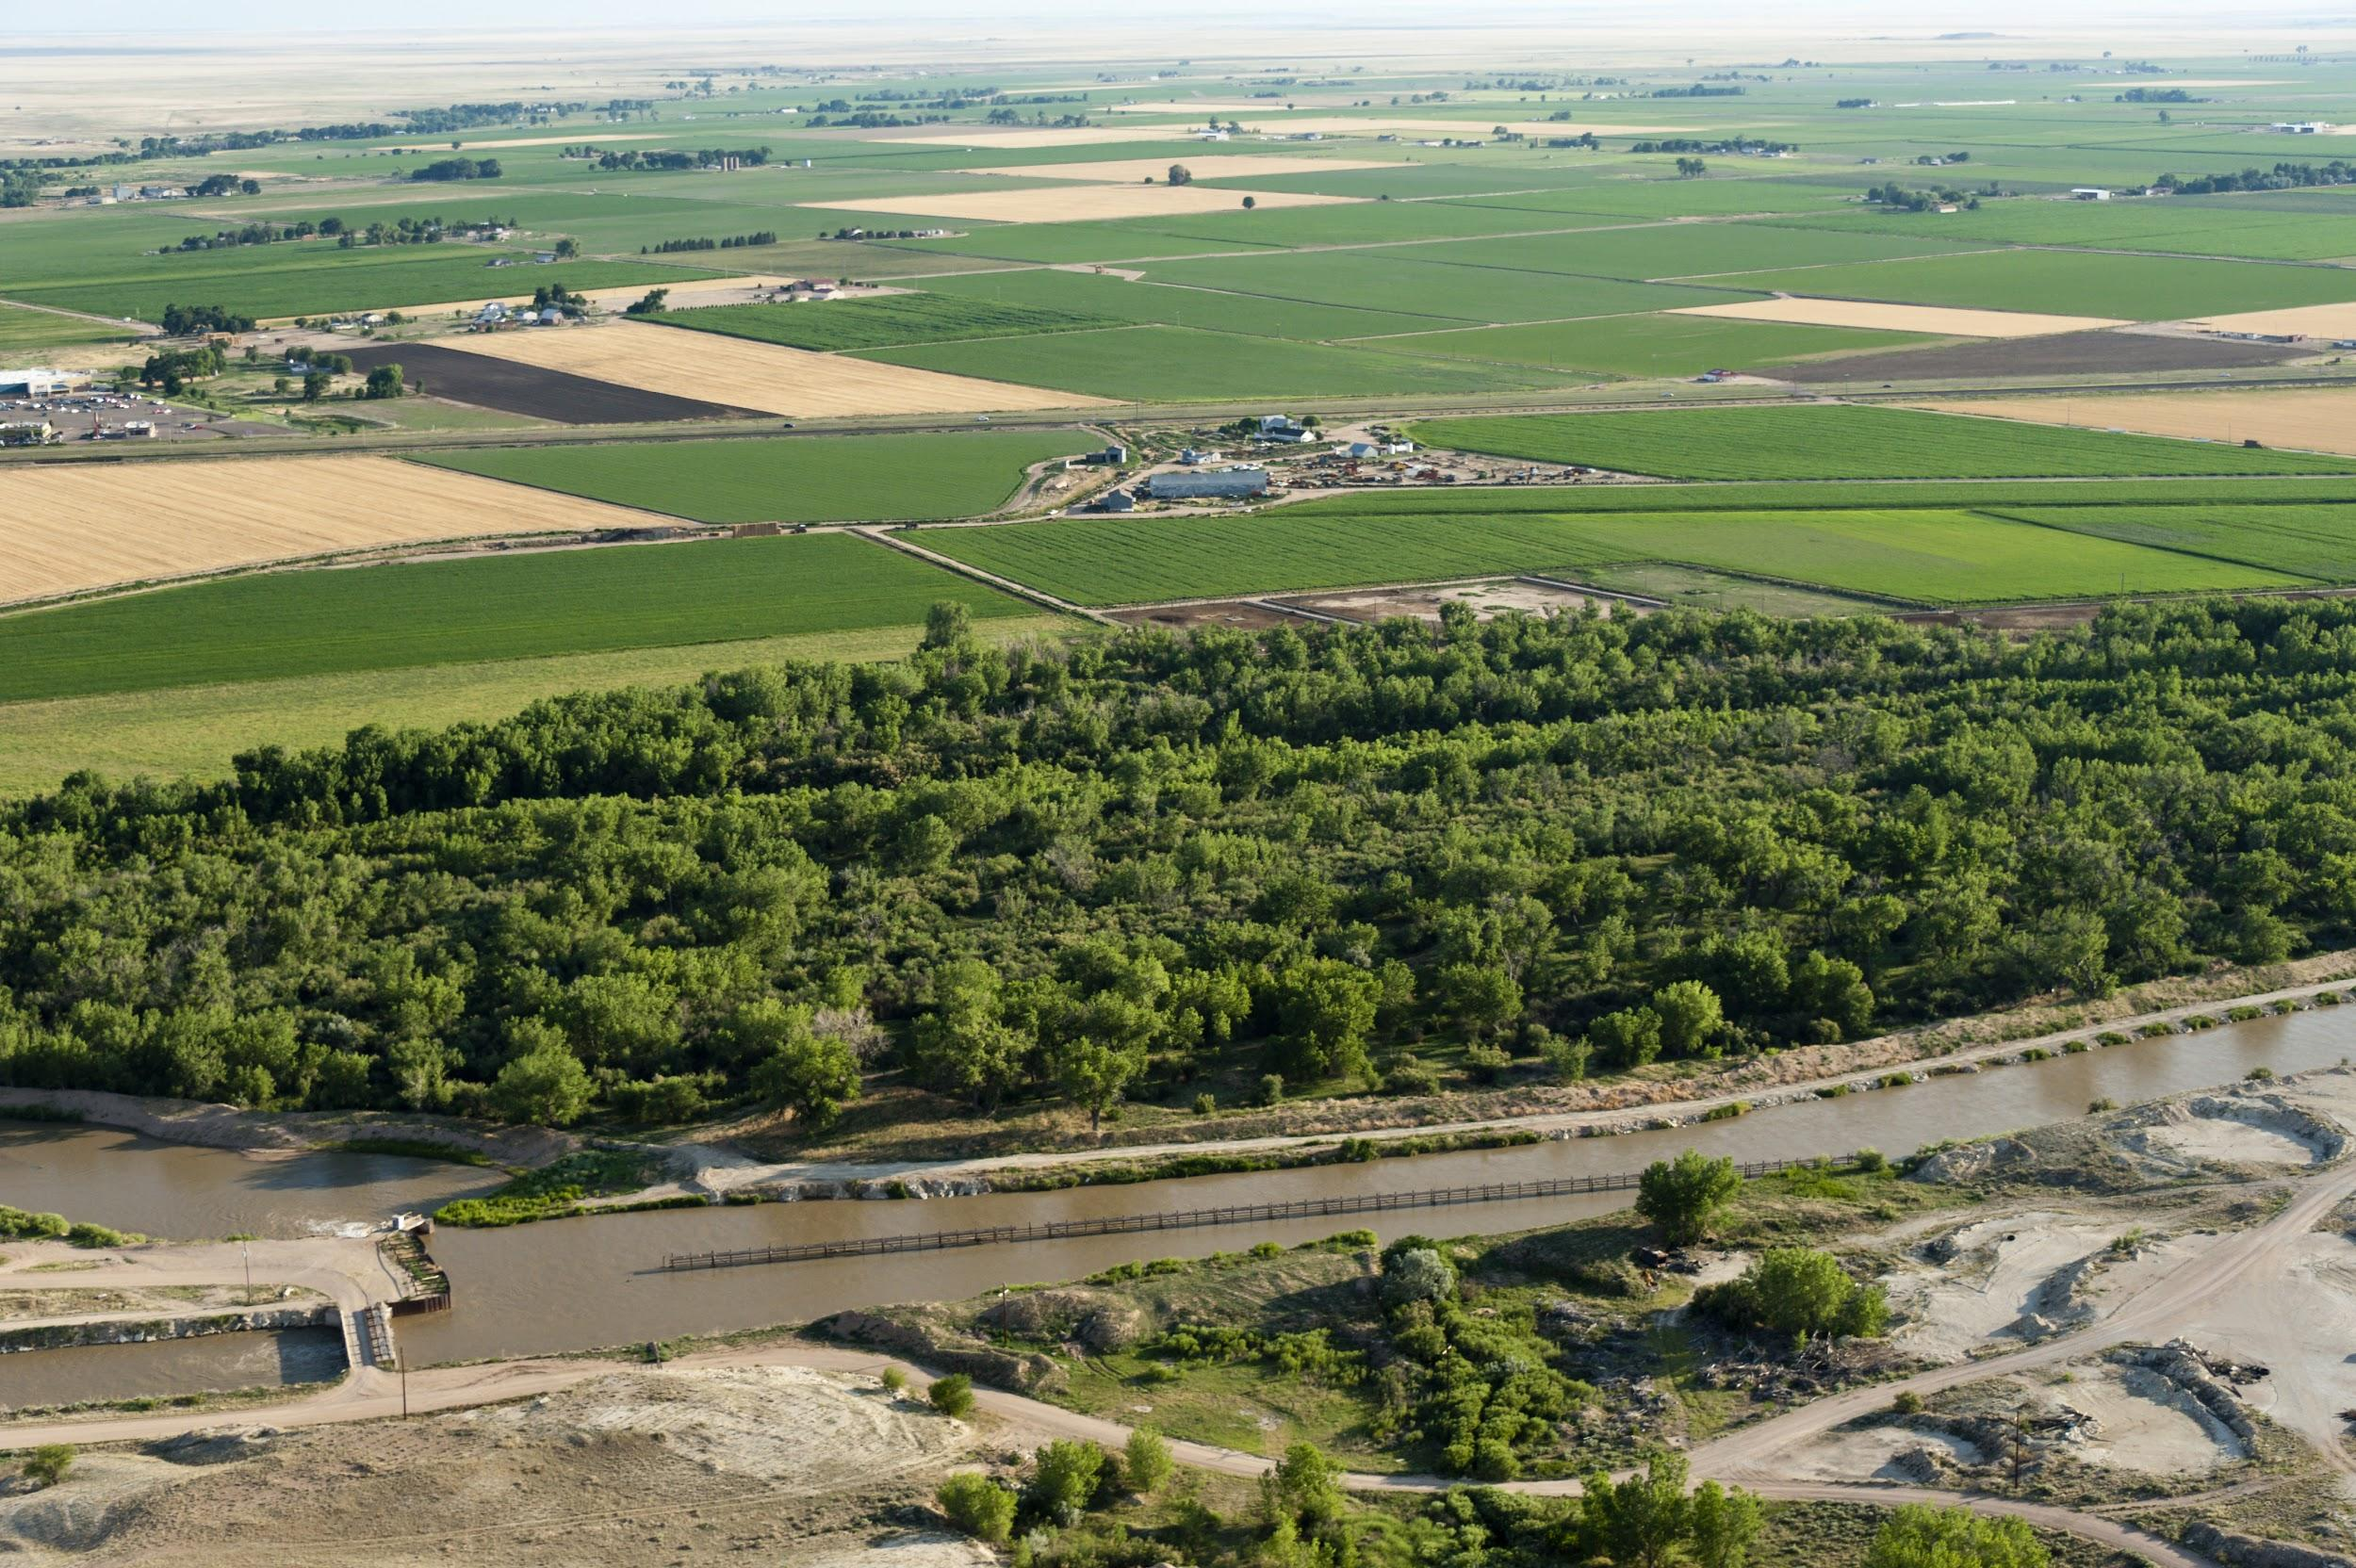
Problem Motivation
A lot of river-operation models are not as physically realistic as they need to be for conjunctive use management/investigations

Slide 4
Problem Motivation
A lot of river-operation models are not as physically realistic as they need to be for conjunctive use management/investigations

Slide 5
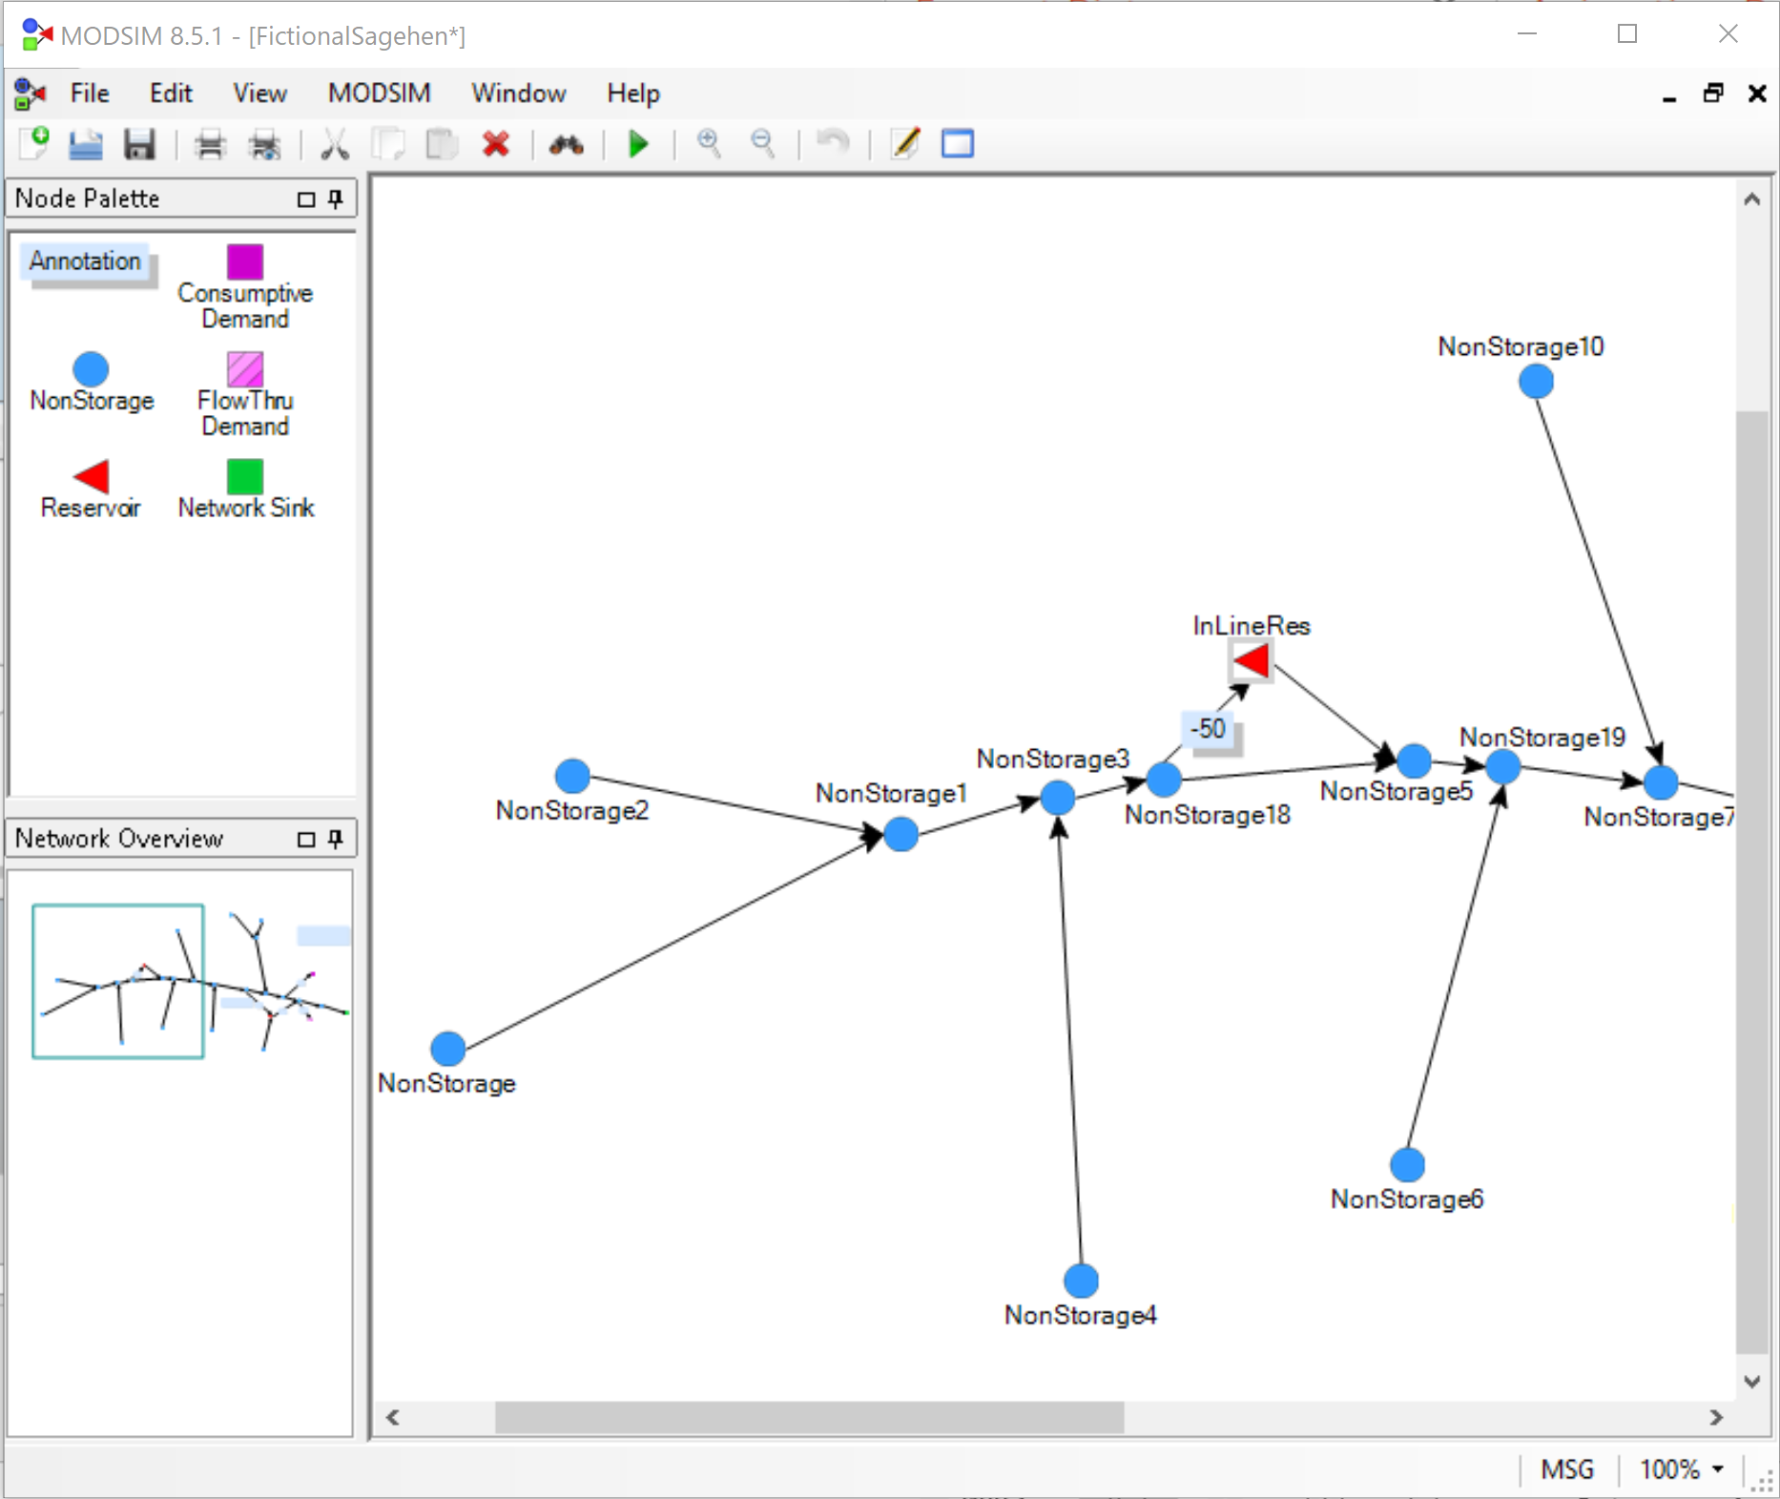
Benefits of Code Integration
Improved representation of spatially distributed groundwater/surface-water exchanges in MODSIM
Glover solution
Aquifer response
functions

Slide 6
Tell me more about MODSIM…

Slide 7
One River Operation Code Among Many
ACRES/ARSP
AQUATOOL
AQUATOR
CalSim/CalSim II
ExcelCRAM
HEC ResSim
IRIS/IRAS
IQQM
MIKE Basin
MISER
MODSIM
MULINO
OASIS
REALM
RIBASIM
RiverWare
Source IMS
StateMod
Stella
WARGI
WASP
WaterWare
WATHNET
WEAP21-IWRM
WRAP

Slide 8
So why MODSIM?
Free
Custom code interface
Quasi-open source
An intuitive, simple GUI
Academic nepotism
Now integrated with GSFLOW
MODSIM-GSFLOW also Free

Slide 9
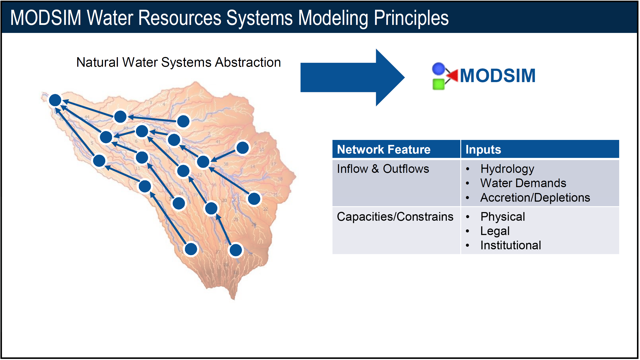
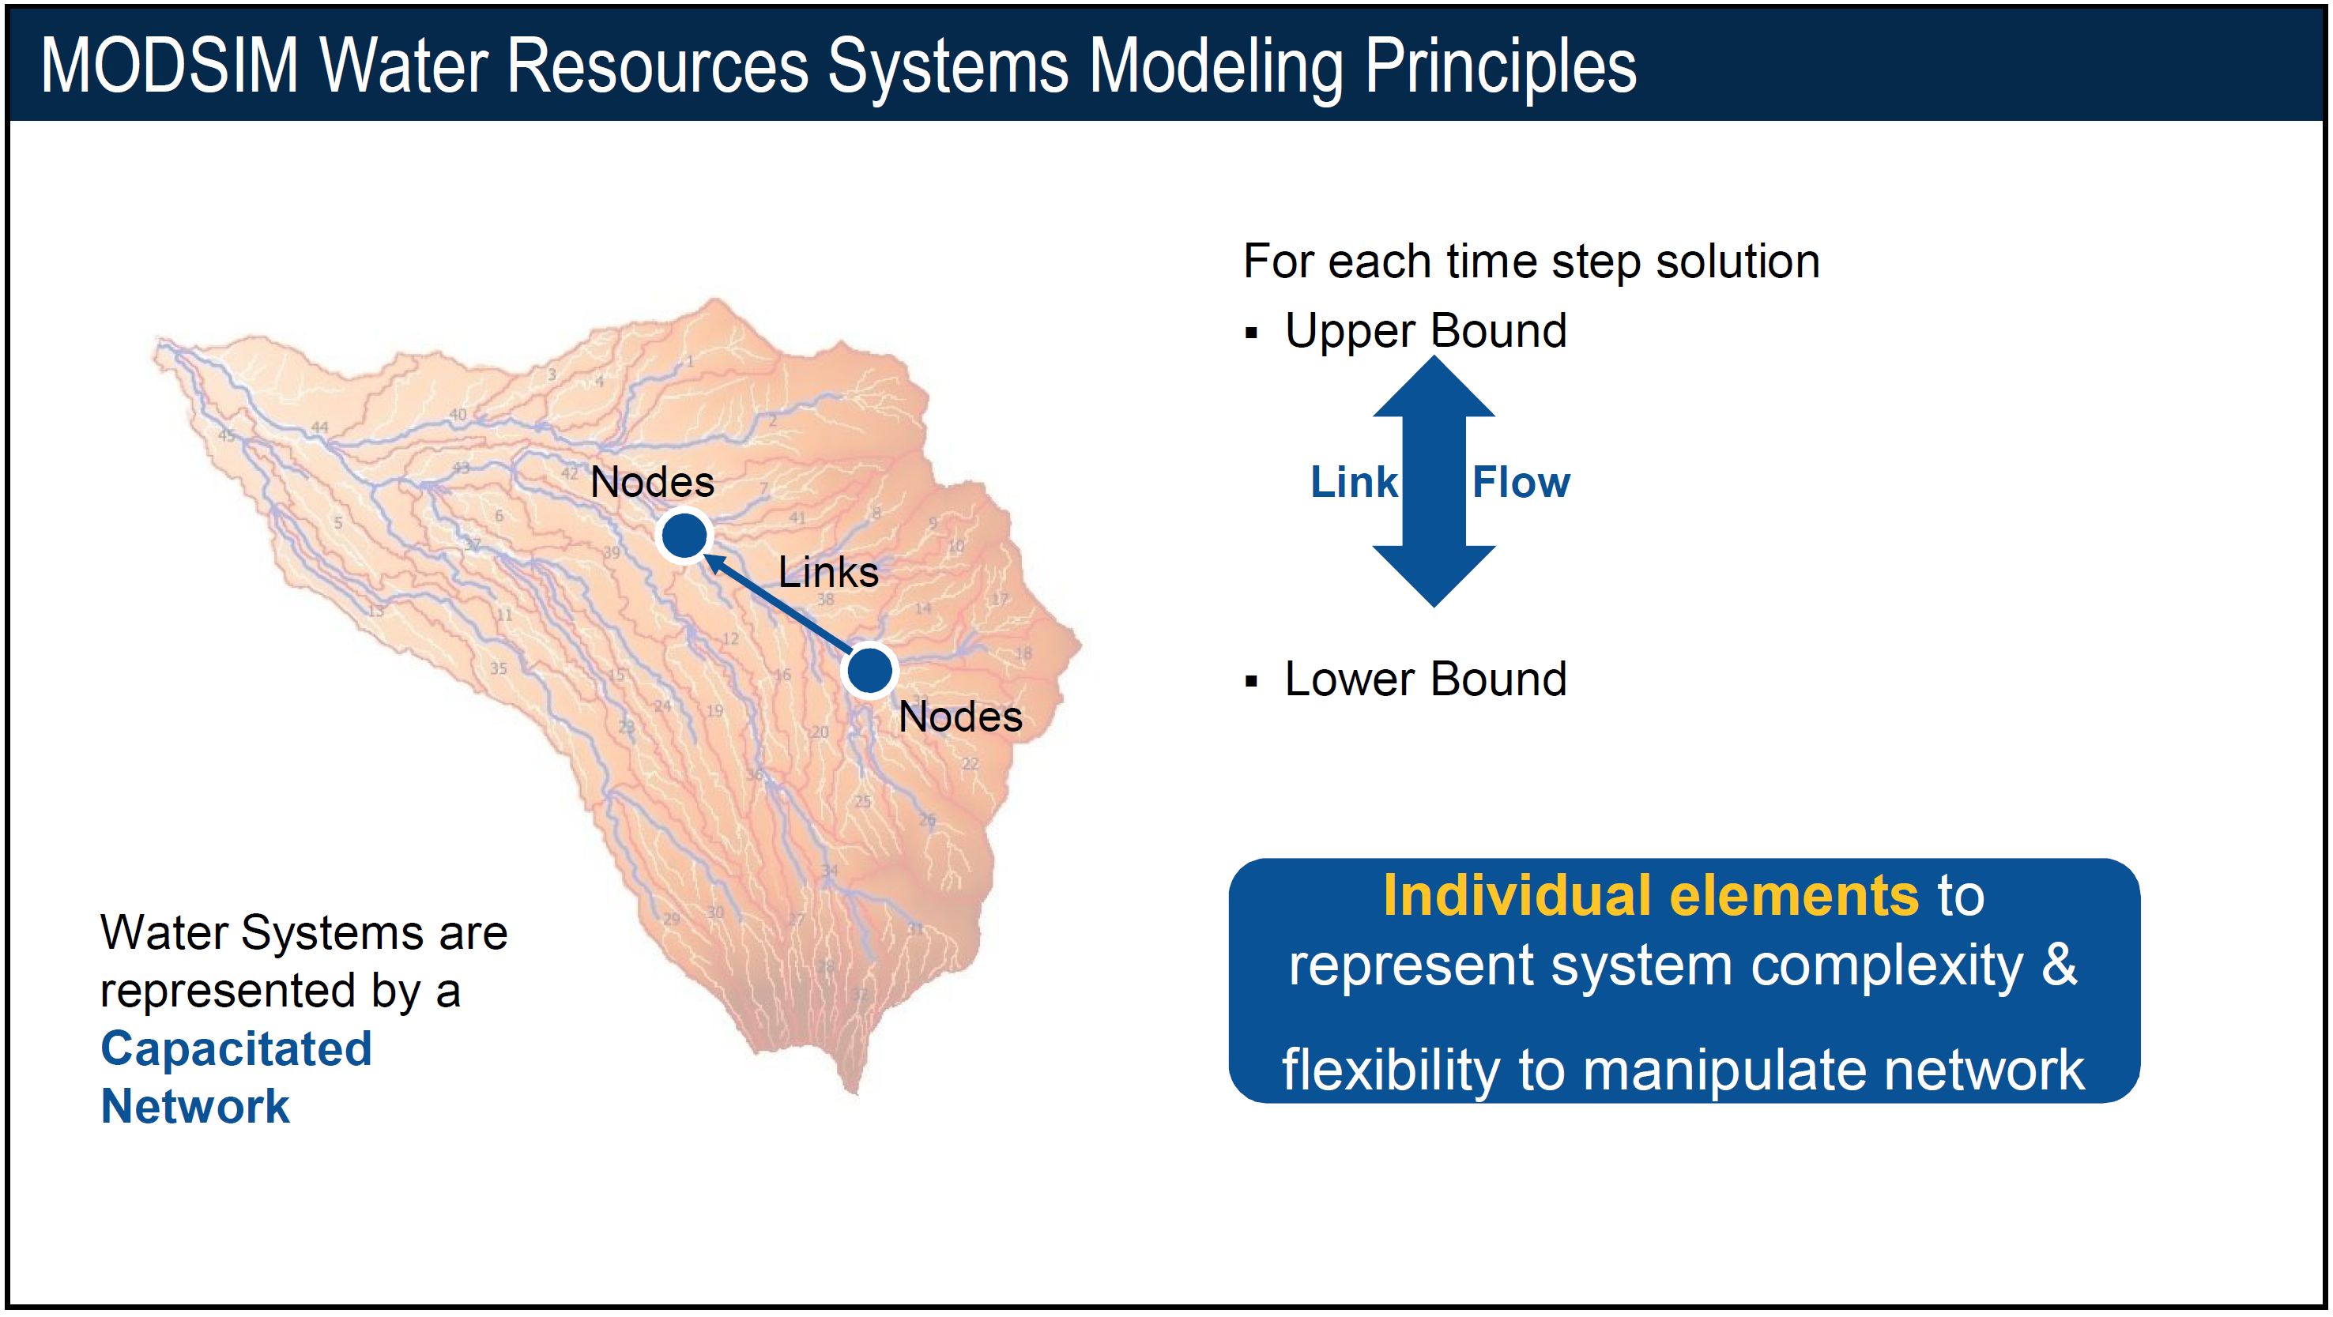

Slide 10
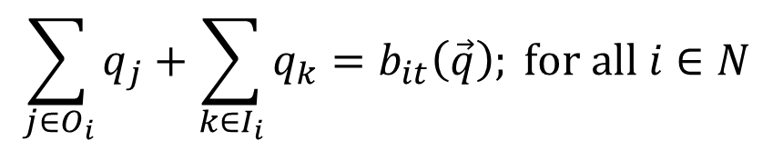
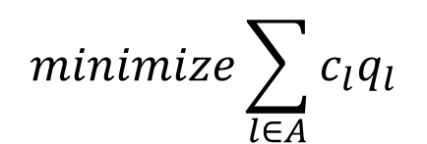
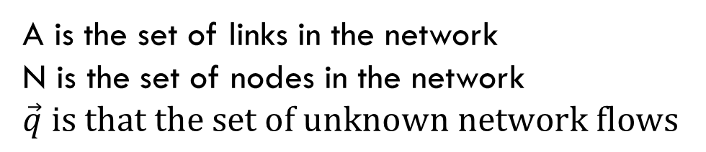
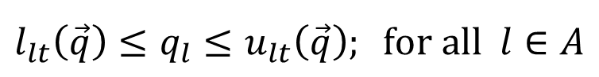
“Under the hood”
$$minimize\sum_{l∈A}{c_{l}q_{l}}$$
$$\sum_{j∈O_{i}}{q_{j}+\sum_{k∈I_{i}}{q_{k}=b_{it}\left(\vec{q}\right); for all i∈N }}$$
$$l_{lt}\left(\vec{q}\right)≤q_{l}≤u_{lt}\left(\vec{q}\right); for all l∈A$$
A is the set of links in the network
N is the set of nodes in the network
$$\vec{q} is that the set of unknown network flows$$

Slide 11
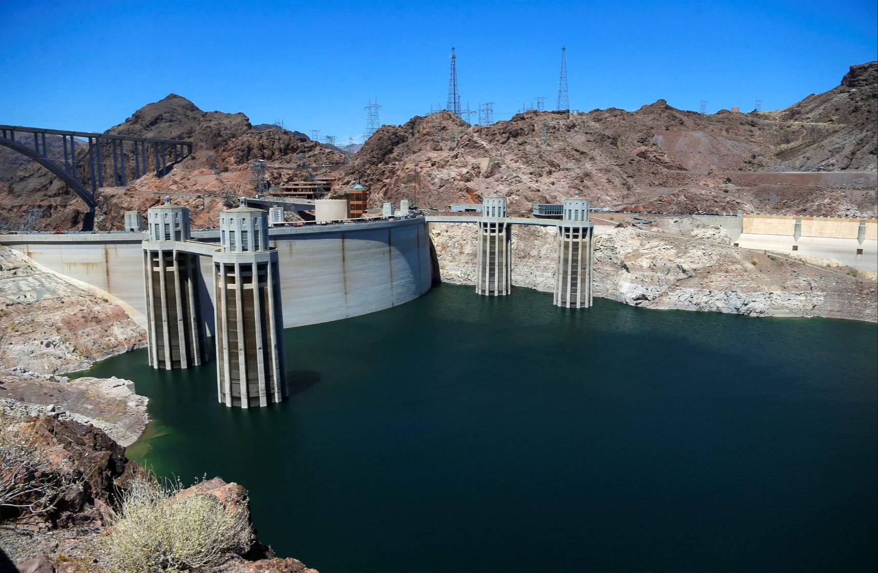

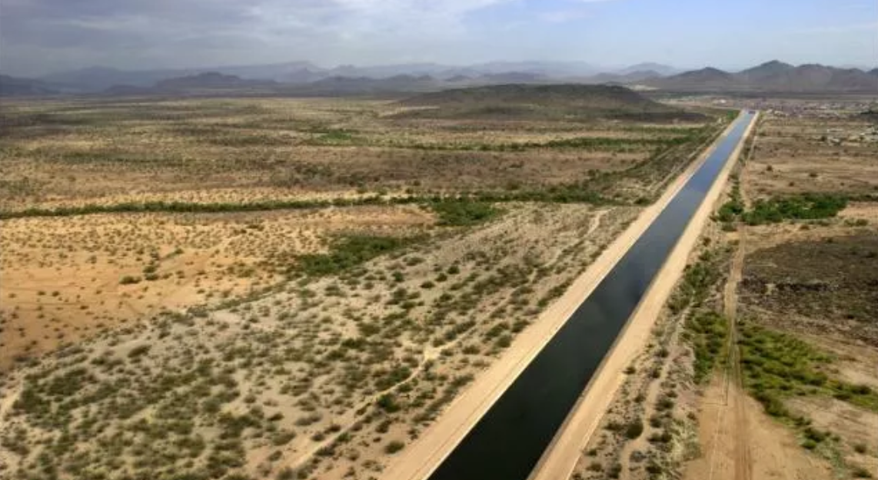


Storage Accounts
California
California
Vegas
Vegas
Arizona
Arizona
Mexico
Mexico

Slide 12
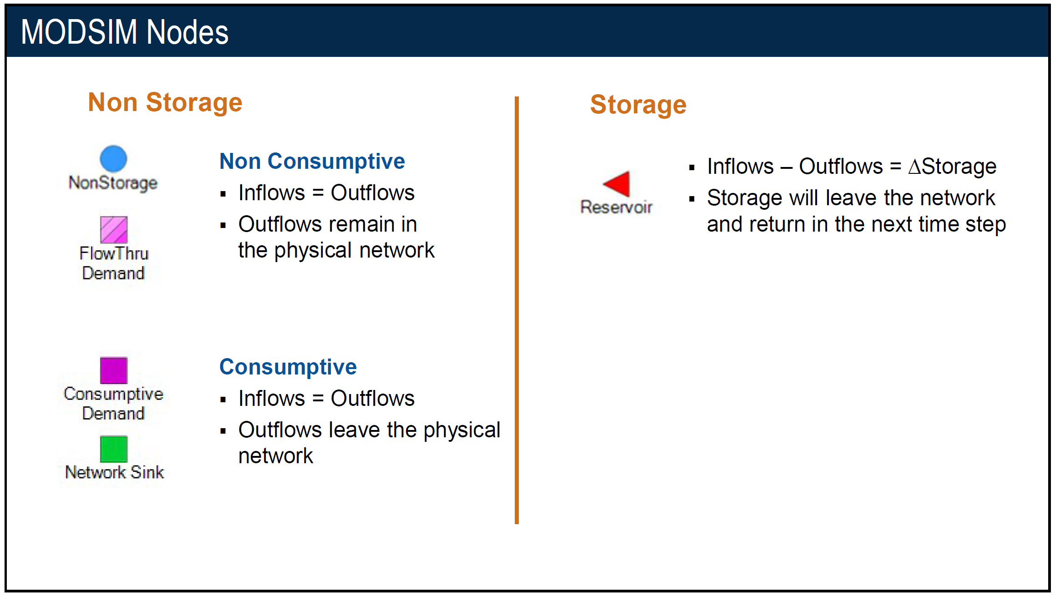

Slide 13
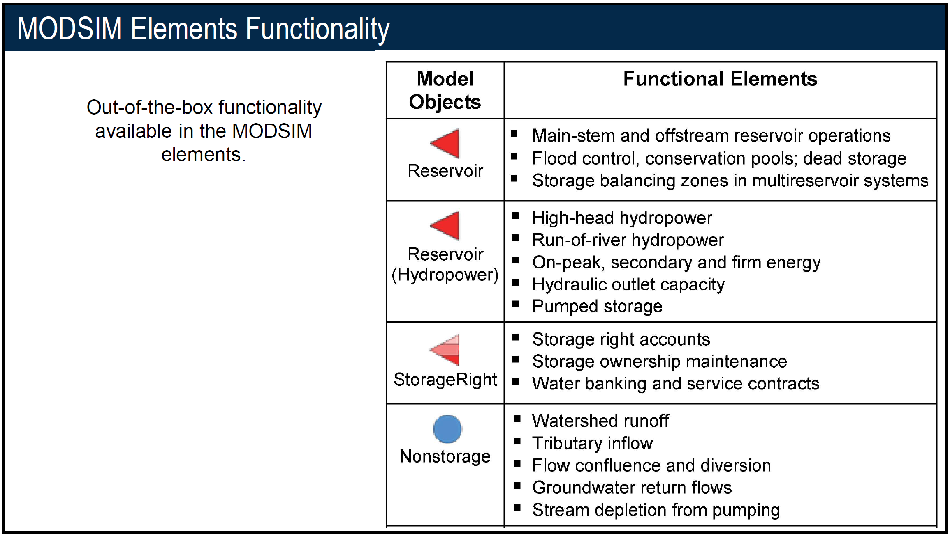

Slide 14
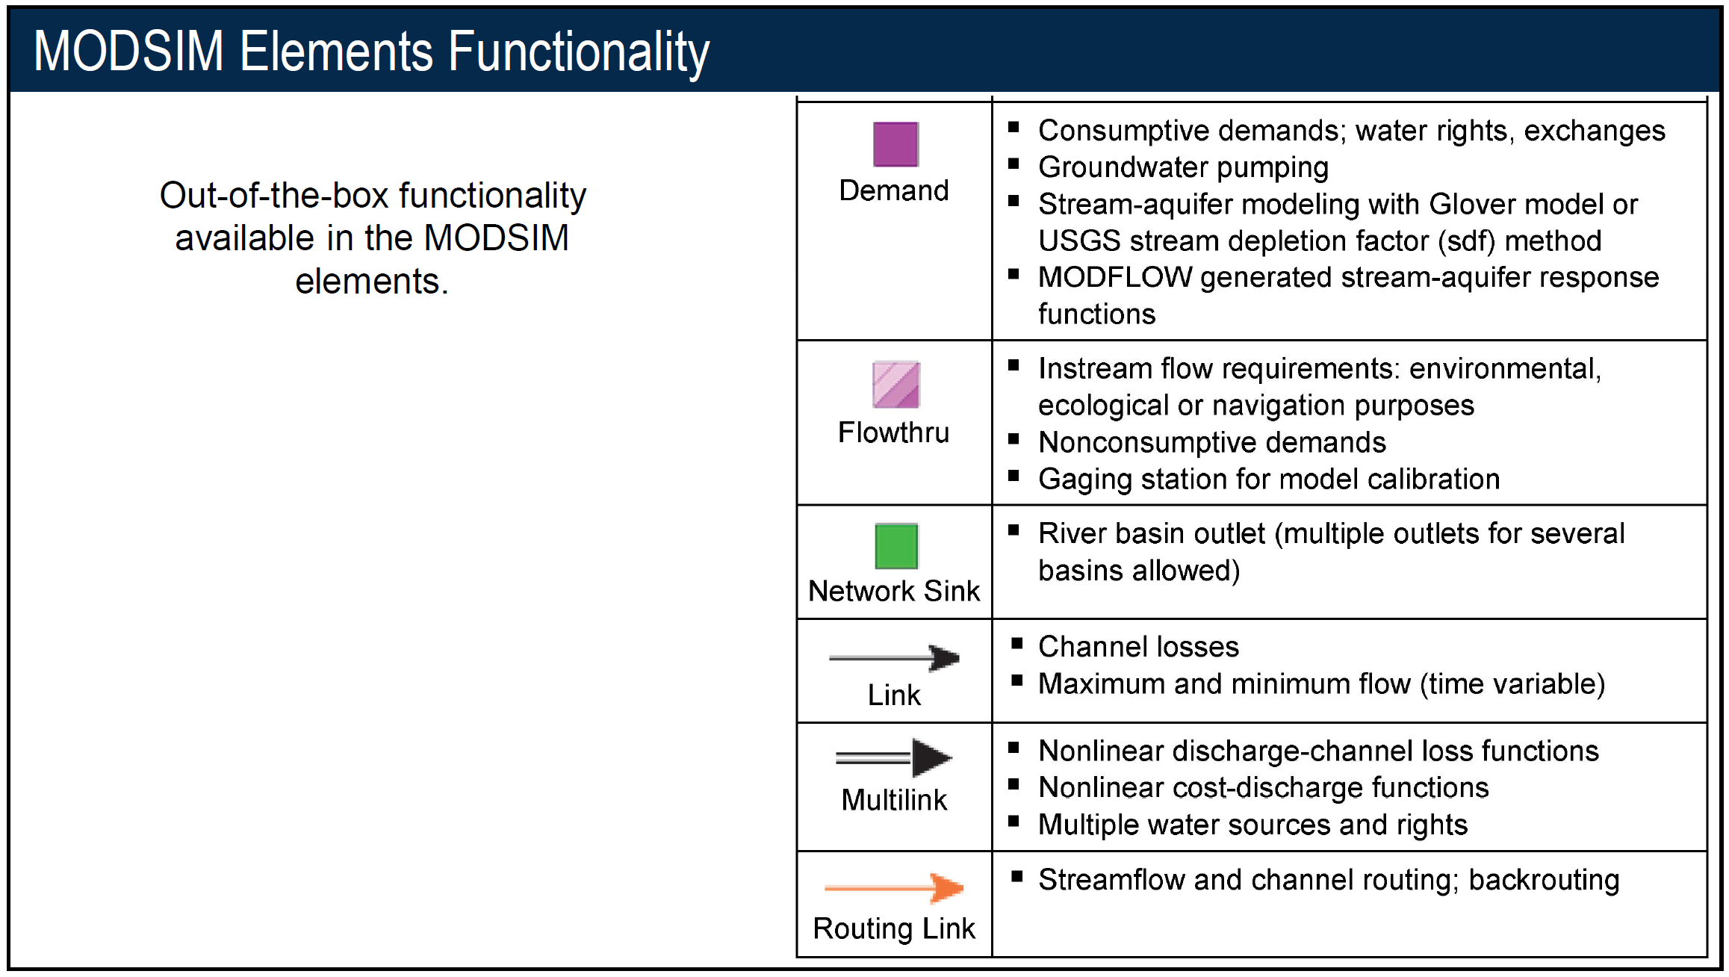

Slide 15
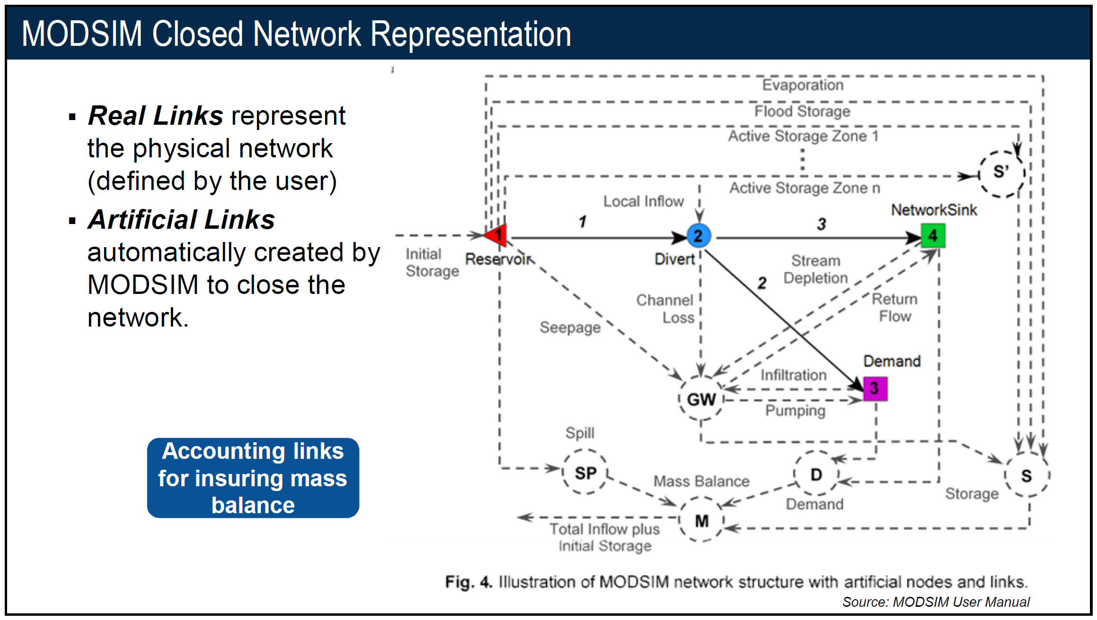
Evaporation
Flood Storage
Active Storage Zone 1
Active Storage Zone n
S’
Initial Storage
Divert
Network Sink
Initial Storage
Reservoir
Channel Loss
Strm Depl.
Return Flow
Seepage
Demand
Infiltration
GW
Pumping
Spill
Storage
SP
D
S
Demand
Total Inflow plus Initial Storage
M
Mass Balance

Slide 16
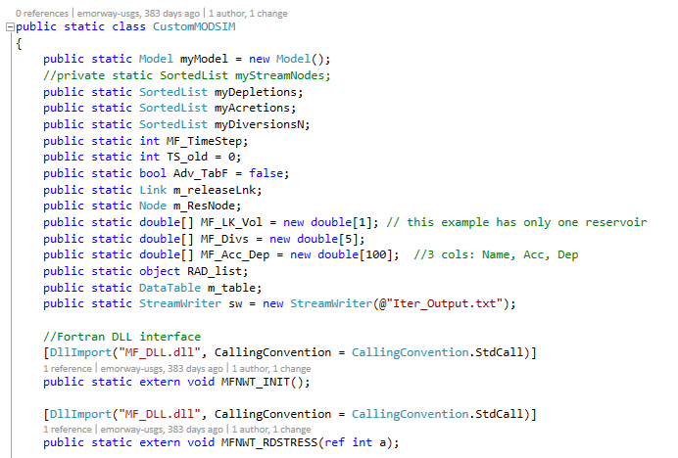
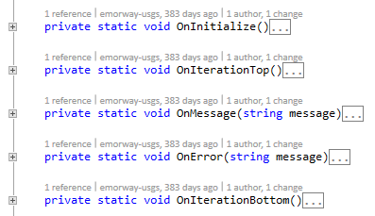
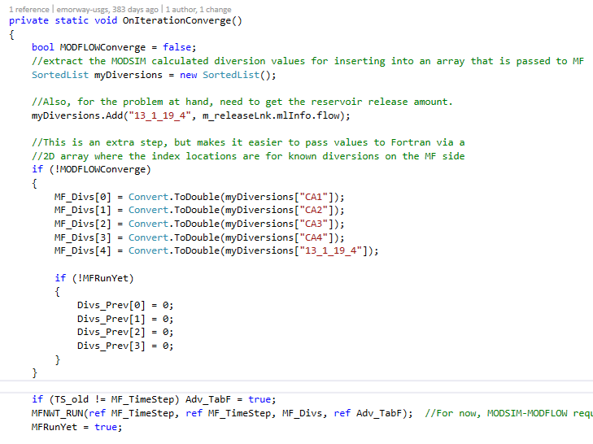
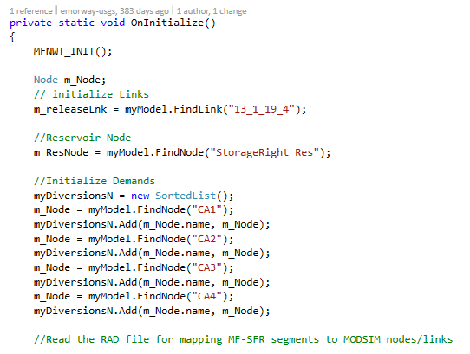
Use Custom Code!

Slide 17
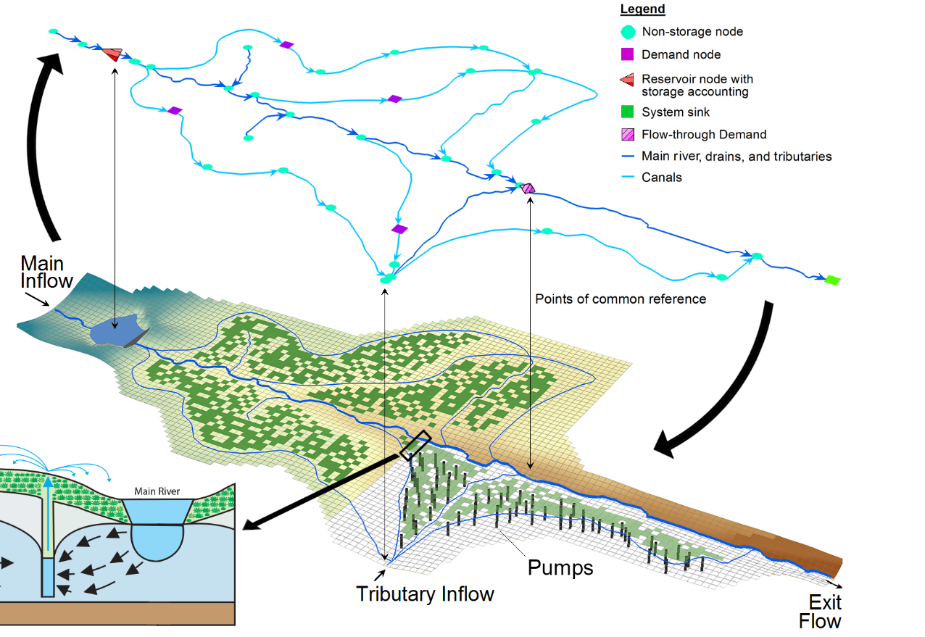

Benefits of Code Integration
All new functionality inside GSFLOW
Simulation of prior appropriation (or similar) including: Reservoir storage accounting runtime diversions based on holistic view of river system

Slide 18

Benefits of Code Integration
Integrated code allows us manage GW and SW as a single resource
Flow, storage, seepage
GSFLOW
Nonlinear iteration
MODSIM
Releases, diversions

Slide 19
A framework that considers Nonlinear Feedbacks
Water markets
Fish spawning
Flow, storage, seepage
Stream temperature, TDS load
Economic models
Ecologic models
Water Quality
GSFLOW
Nonlinear iteration
MODSIM
Releases, diversions
Notes:
Our intention in the future is to add transport, or economic considerations.
How is MS-MF and MS-GSF seperate from the other work. For planning efforts need longer time steps, so this highlights the need for implicit coupling (this slide).
Point out that other models could be called using the existing API approach. Allows us to bring
In the past we’ve simulated a view of the world in a dis-jointed way. Our effort alleviates this, and MS-GSF is one example.

Slide 20
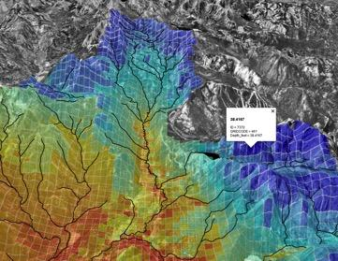

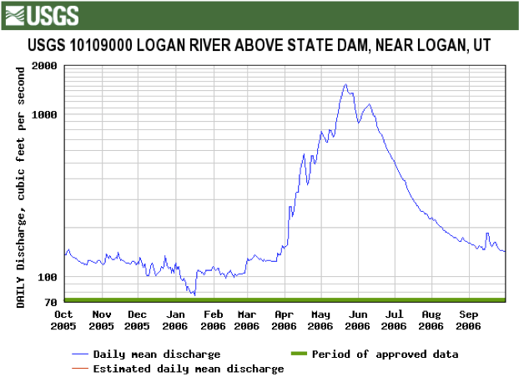
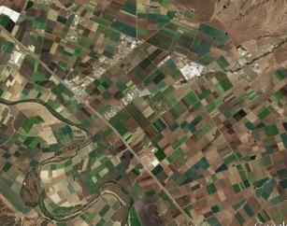
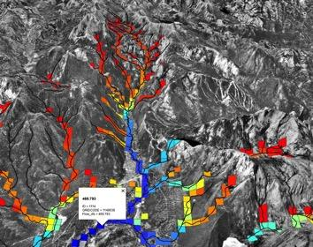

Components of water supply and consumption
Water allocations for agricultural, municipal, and industrial uses; conjunctive use
Snowpack, rain, river, and groundwater storage forecast
Runoff to rivers

Slide 21
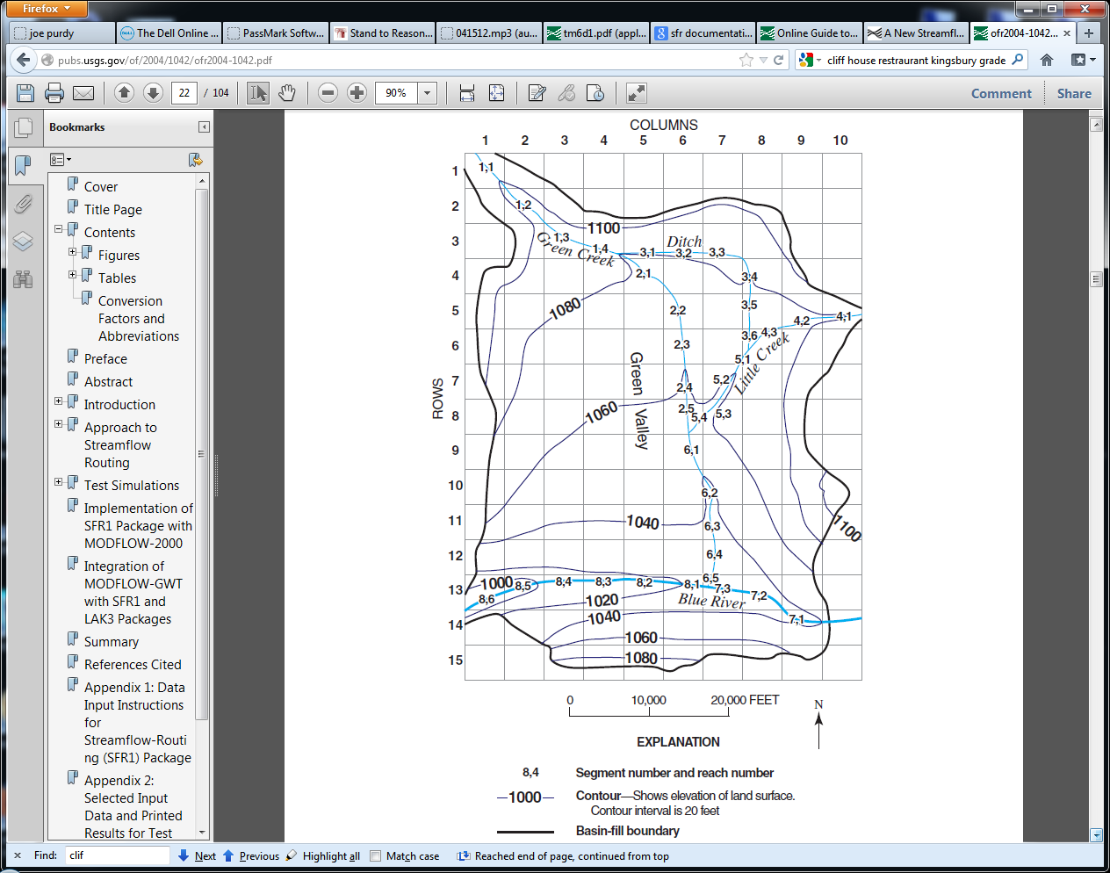
MODSIM-GSFLOW Integration: Same system, 2 representations
Physically-based, distributed-parameter hydrologic model
Link-node network-flow model
Demand
Demand

Slide 22
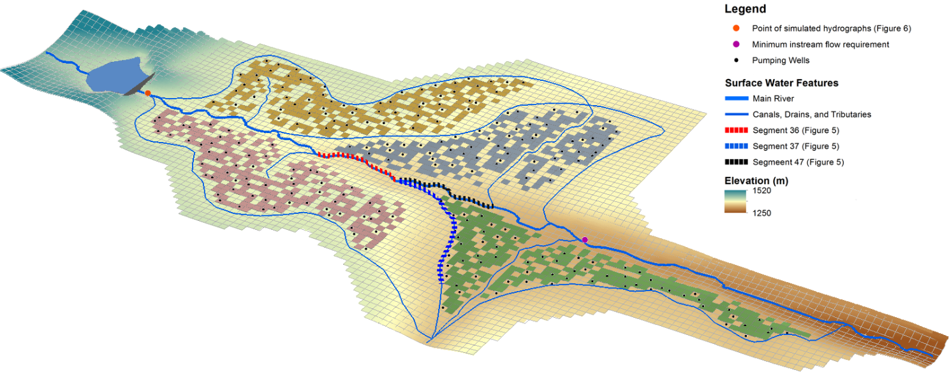
Integrated Operations-Hydrology Model
Releases & diversions based on holistic operation of the system informed by the feedbacks between the GW and SW systems
Cell-by-cell GW-SW exchange
CA2
CA1
CA3
Minimum instream flow requirement
Seniority
CA4
Notes:
In addition, MODSIM can simulate releases from the reservoir based on storage levels in the reservoir and shortfalls in the network. It is worth pointing out that there may be “owned” water in the reservoir that needs to be routed to its owner regardless of priorities in the system. As a result, this “contracted” water may need to flow past more senior points of diversion while being delivered, something MODSIM can take care of for us.
Note: Make the point that MF can’t make a diversion decision based on some other point in the model. However, with the integrated code we can make decisions with the entire network in view. It is not as simple as “oh, we can drop a weir in our model”…we’re going beyond that
With MODSIM alone, how are we going to account the dispersed pumping (black dots) and its effect on streamflow?

